Slide 1
DIMENSIONALITY REDUCTION
ASADUJAMAN NUR

Slide 2
PREVIEW
DIMENSIONALITY REDUCTION
Introduction
History
Methods
PCA
Pros & Cons
Future

Slide 3
INTRODUCTION
DIMENSIONALITY REDUCTION
Dimensionality Reduction
Machine Learning
Unsupervised Learning
Use cases

Slide 4
HISTORY
DIMENSIONALITY REDUCTION
1950 Idea of machine Learning.
1957 First computer neural Network by Frank Rosenblatt.
1959 “Bernard Widrow” & “Marcian Hoff” created two neural model.
2002 IBM Watson beat 2 human champion
2016 Alpha go beat human champion

Slide 5
METHOD
DIMENSIONALITY REDUCTION
Feature Selection
Feature Extraction
PCA
Kernel PCA
Linear Regression
Lasso Regression

Slide 6
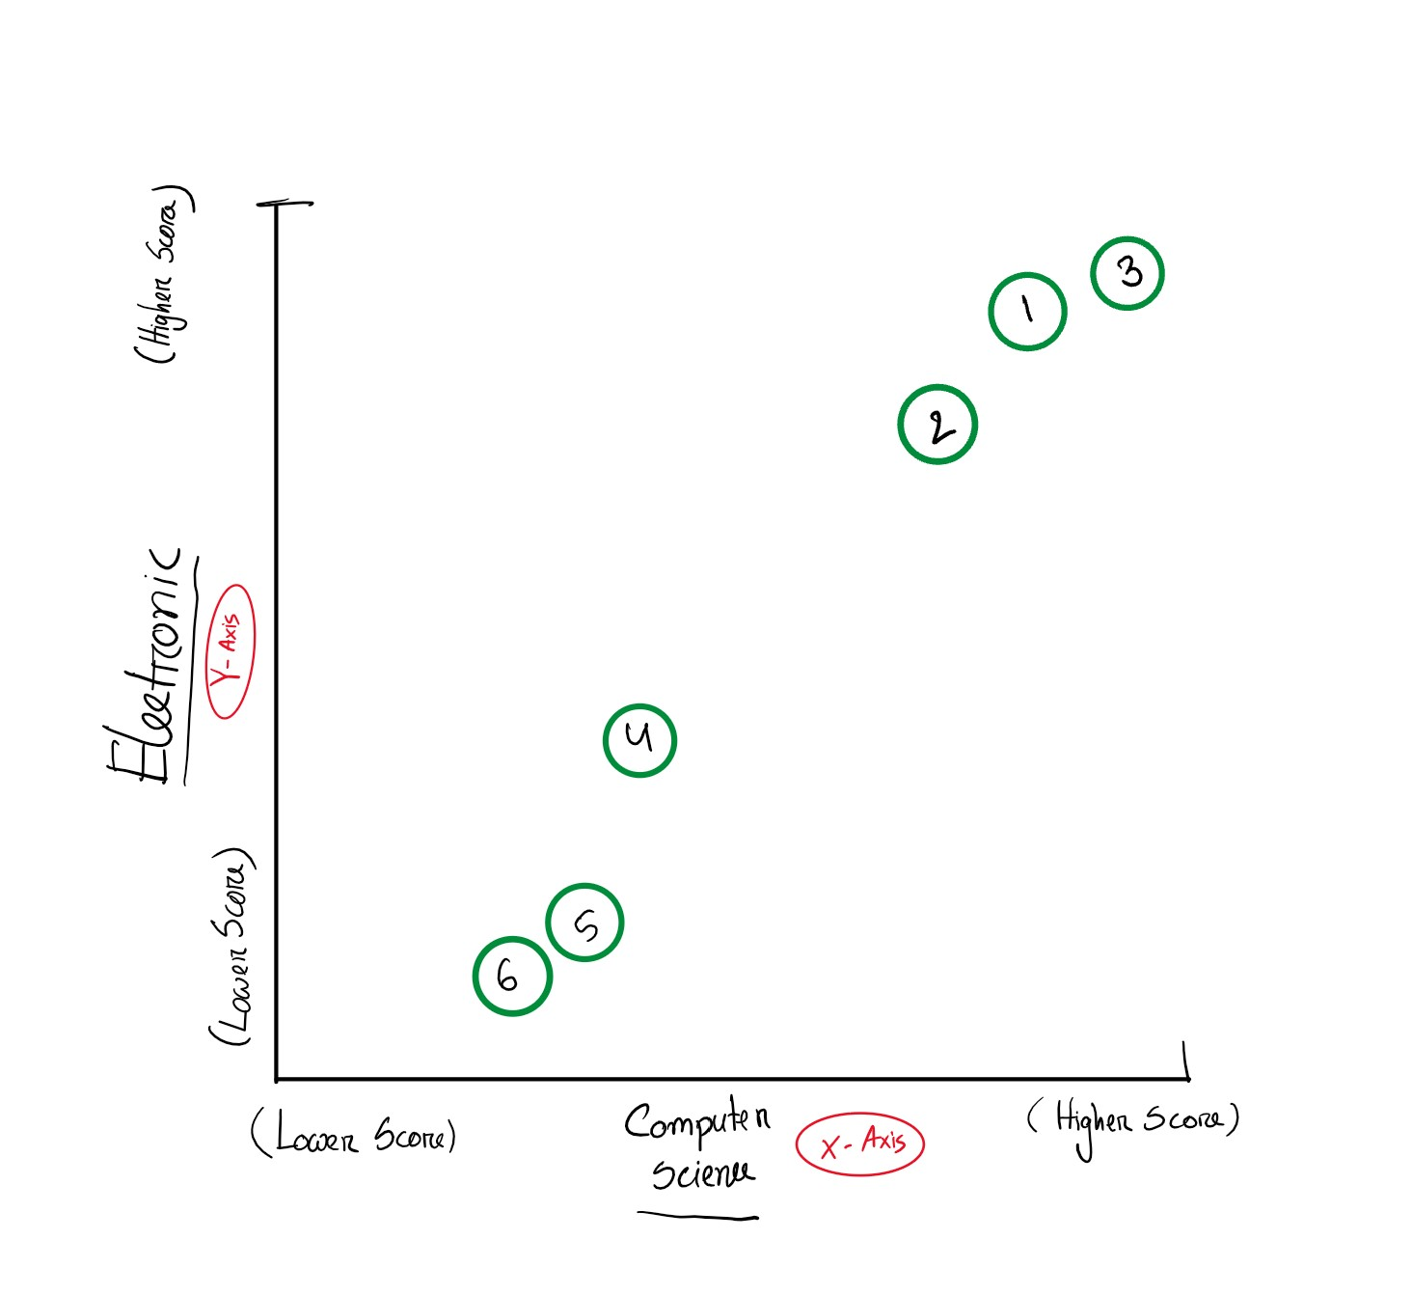
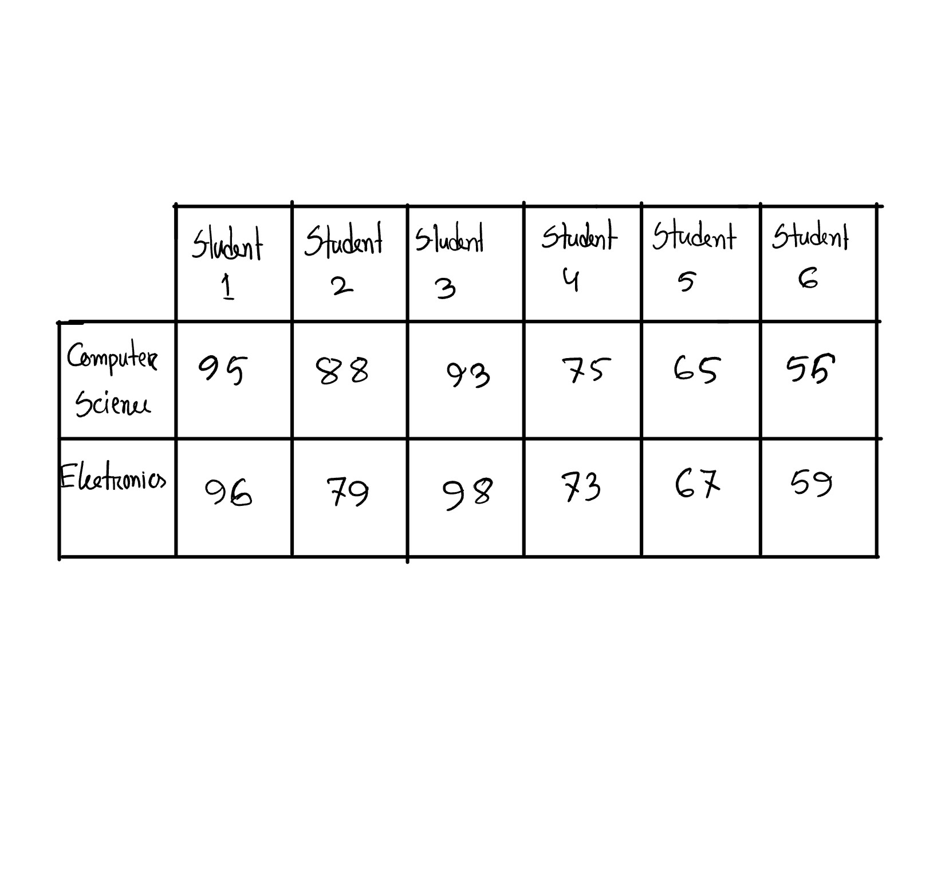
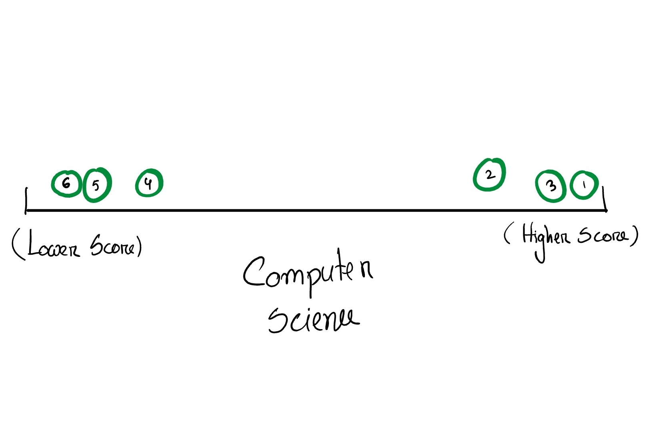
PCA
PRINCIPLE COMPONENT ANALYSIS
DATA SHEET
2 DIMENSION DATA REPRENTATION
1 DIMENSION DATA REPRENTATION

Slide 7
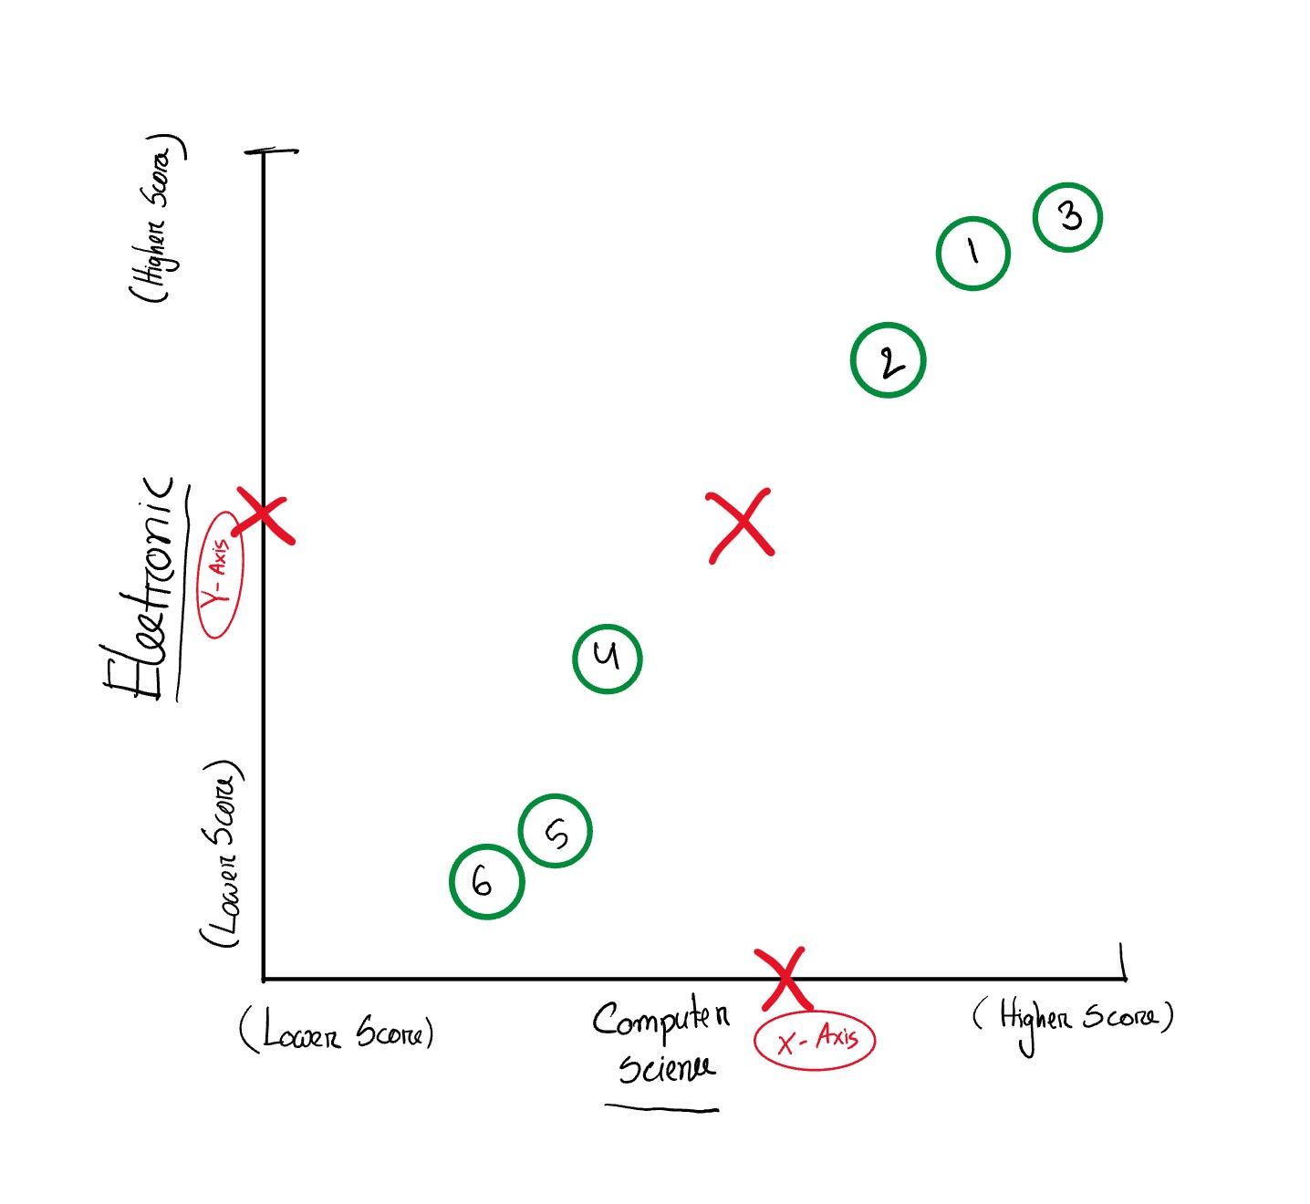
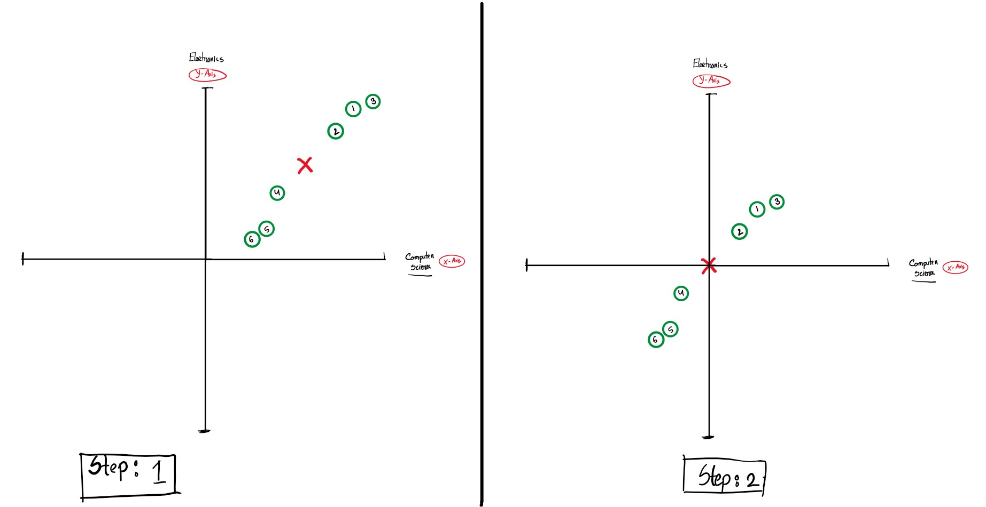
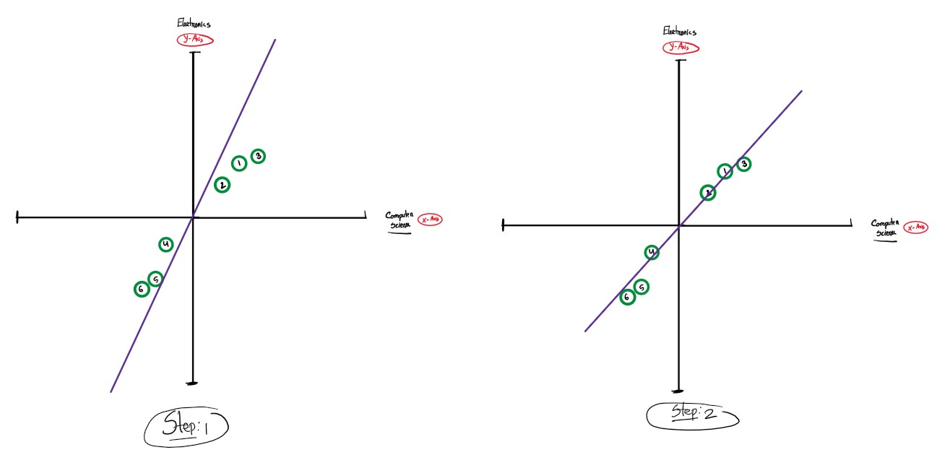
PCA
PRINCIPLE COMPONENT ANALYSIS
FINDING AVERAGE SCORE
DATA RELOCATION
PROJECTING TO PCA

Slide 8
PROS & CONS
DIMENSIONALITY REDUCTION
Advantages
Data Compression.
Storage Space.
Computation & Data Storage.
Assistance Removing Redundant feature
Disadvantages
Data Loss.

Slide 9
DIMENSIONALITY REDUCTION
FUTURE OF
Role in Machine Learning.
Robotics and CPS
Automotive industries
Industry 4.0

Slide 10
THANK YOU FOR LISTENING

